Slide 2
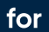

ADVERSARIAL EXAMPLES against MACHINE LEARNING
ENGINEERING MACHINE LEARNING
HEALTH TECHNOLOGY
______________
High Noon SHOWDOWN
______________
______________

Slide 3
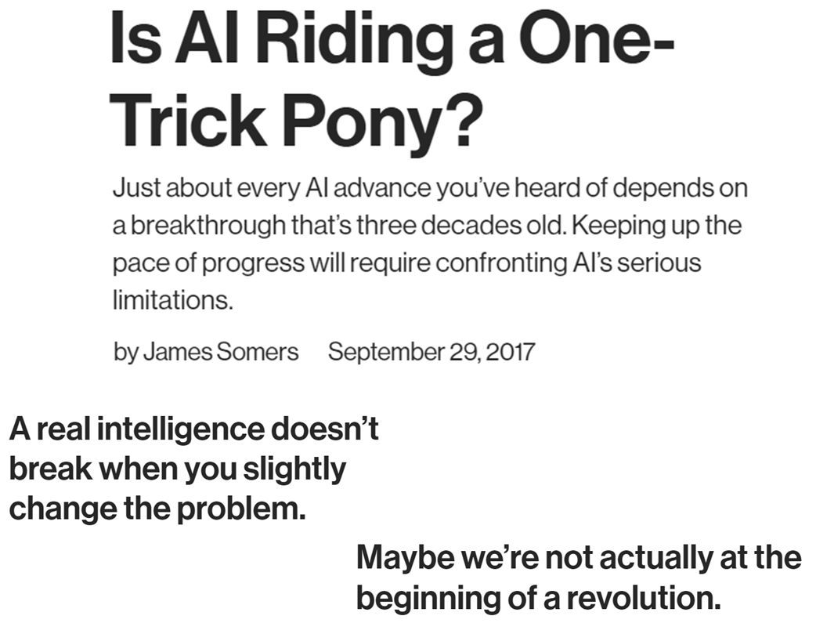
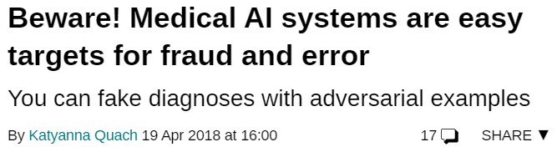
AdversArial examples
WHAT ARE ADVERSARIAL EXAMPLES?
Test examples that ‘break’ the system
Can be:
Malicious
Accidental
Just unusual

Slide 4
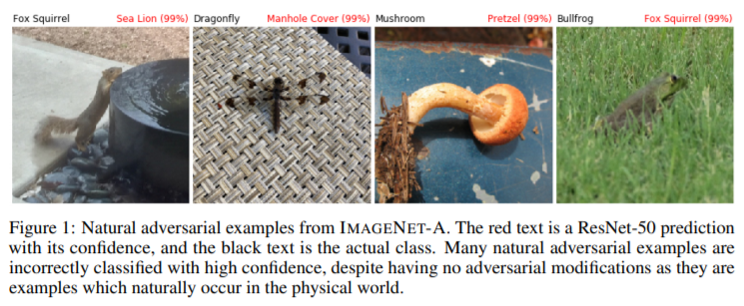
AdversArial examples
WHAT ARE ADVERSARIAL EXAMPLES?
Test examples that ‘break’ the system
Can be:
Malicious
Accidental
Just unusual
https://arxiv.org/pdf/1907.07174v2.pdf

Slide 5
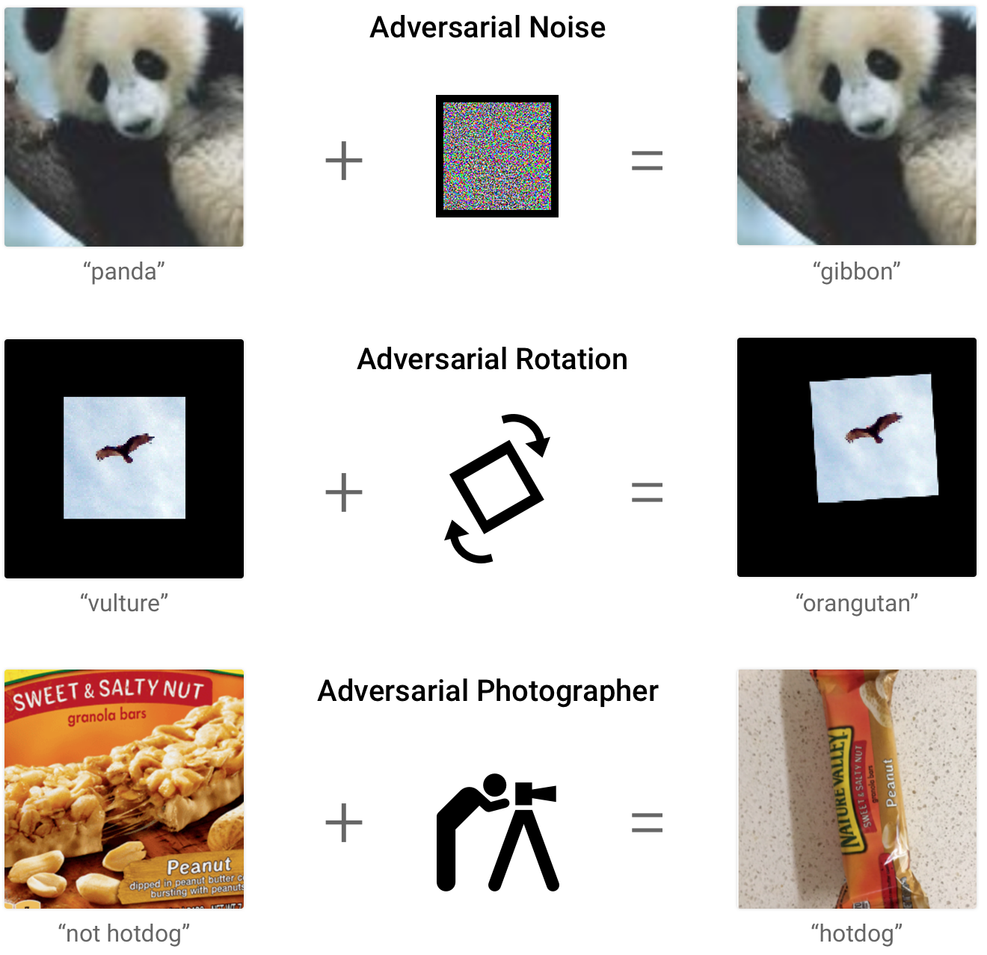
AdversArial examples
EXAMPLES OF ADVERSARIAL EXAMPLES

Slide 6
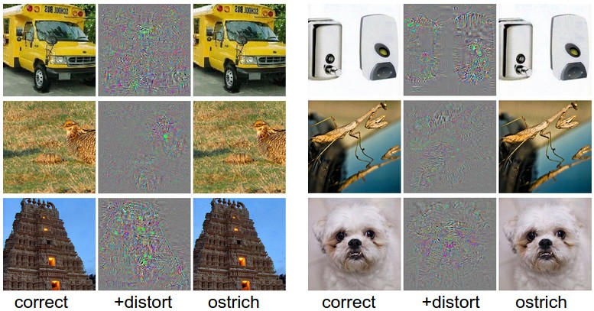
AdversArial examples
EXAMPLES OF ADVERSARIAL EXAMPLES

Slide 7
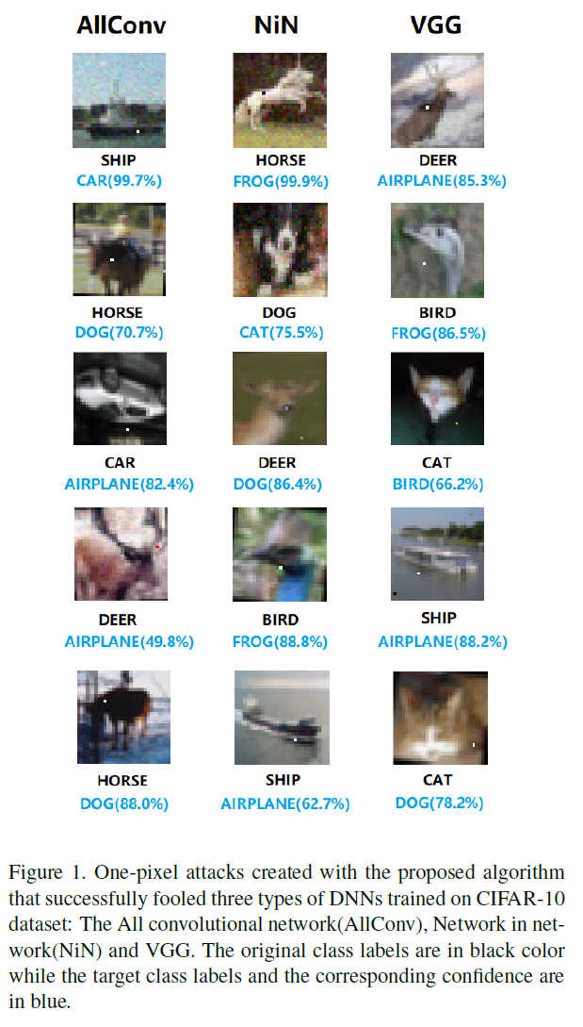

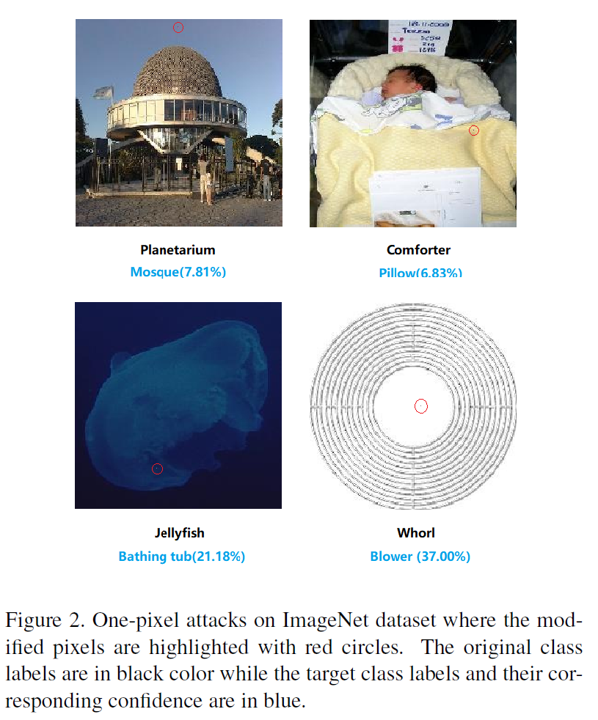
AdversArial examples
EXAMPLES OF ADVERSARIAL EXAMPLES

Slide 8
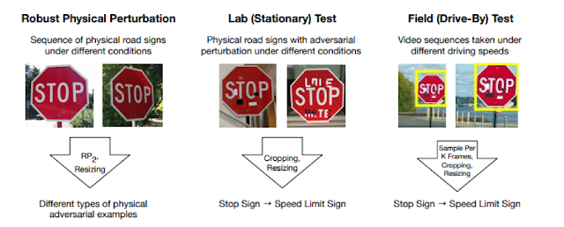
AdversArial examples
EXAMPLES OF ADVERSARIAL EXAMPLES

Slide 9
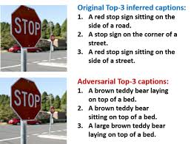
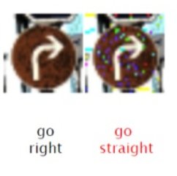
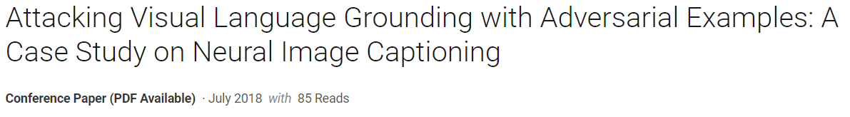
AdversArial examples
EXAMPLES OF ADVERSARIAL EXAMPLES

Slide 10
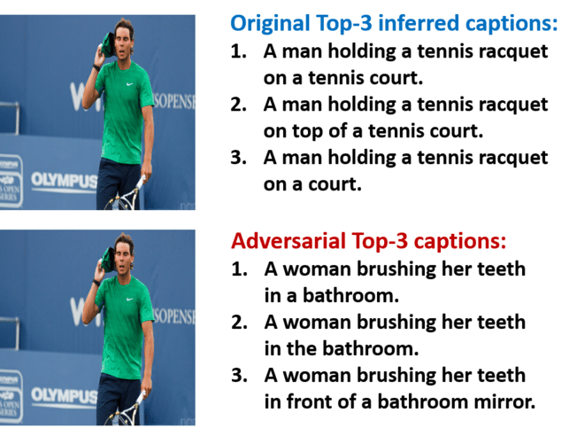
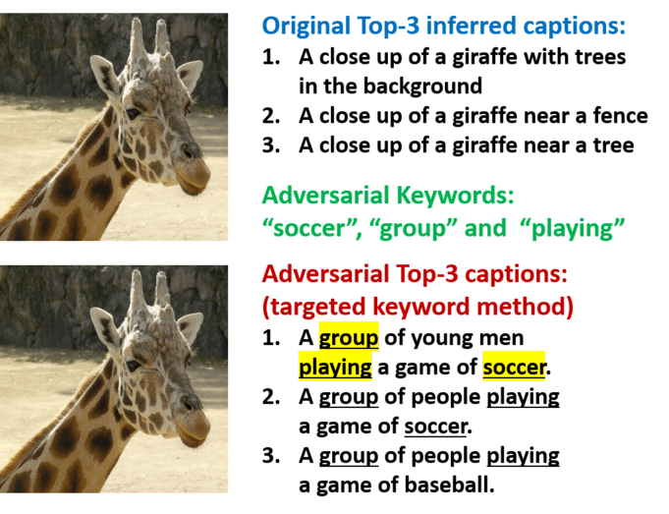
AdversArial examples
EXAMPLES OF ADVERSARIAL EXAMPLES

Slide 11
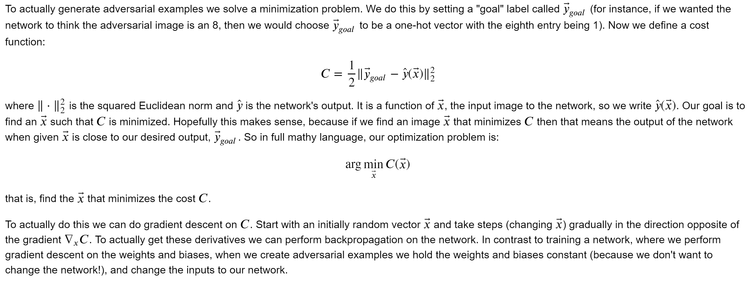
AdversArial examples
DEMO OF ADVERSARIAL EXAMPLES

Slide 12
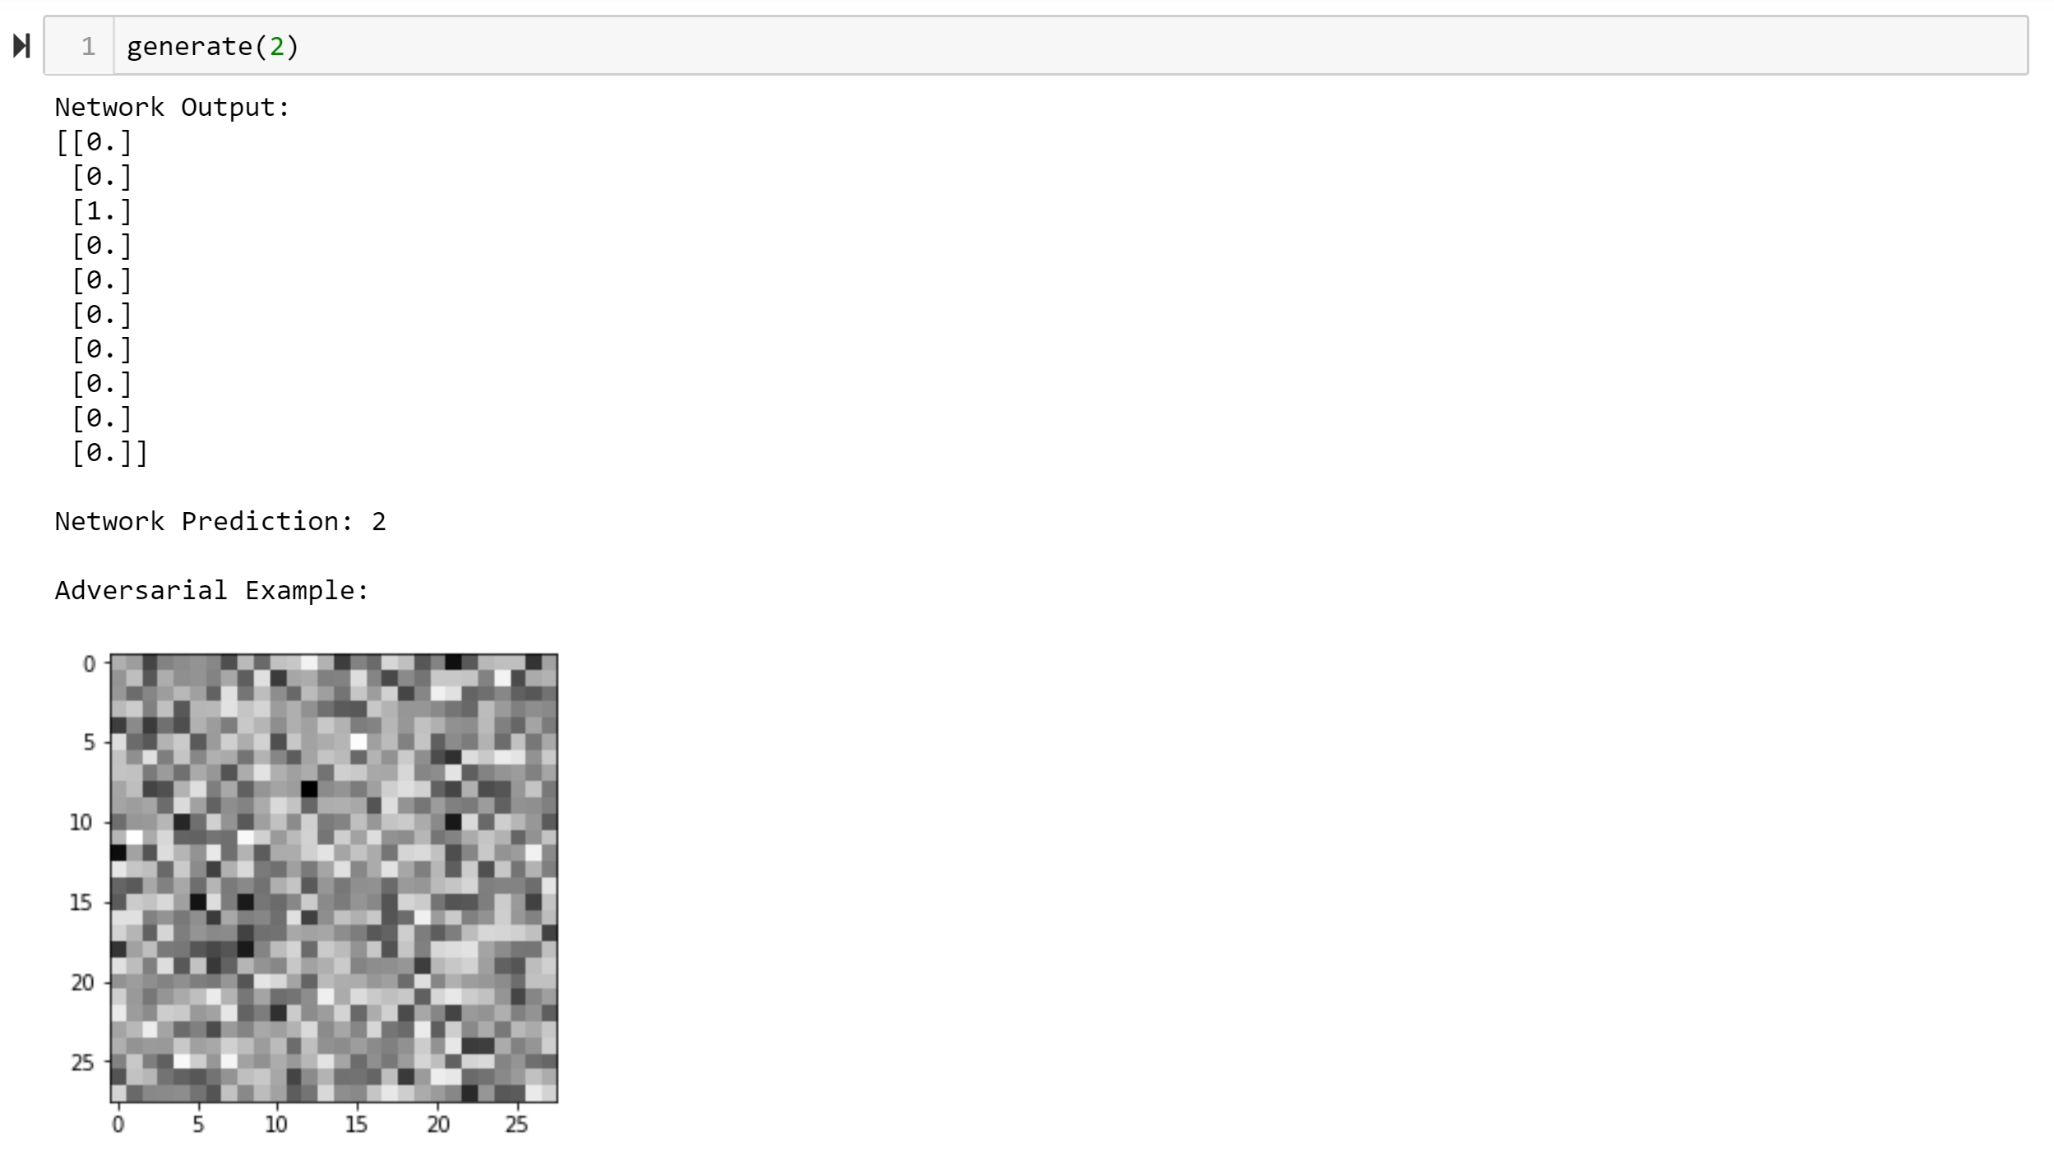
AdversArial examples
DEMO OF ADVERSARIAL EXAMPLES

Slide 13
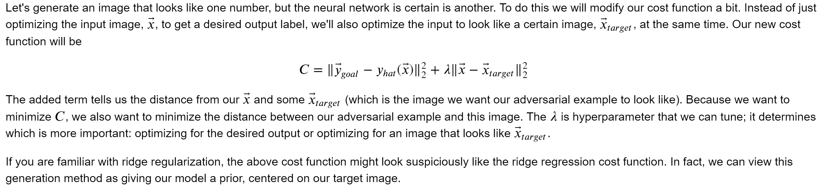
AdversArial examples
DEMO OF ADVERSARIAL EXAMPLES

Slide 14
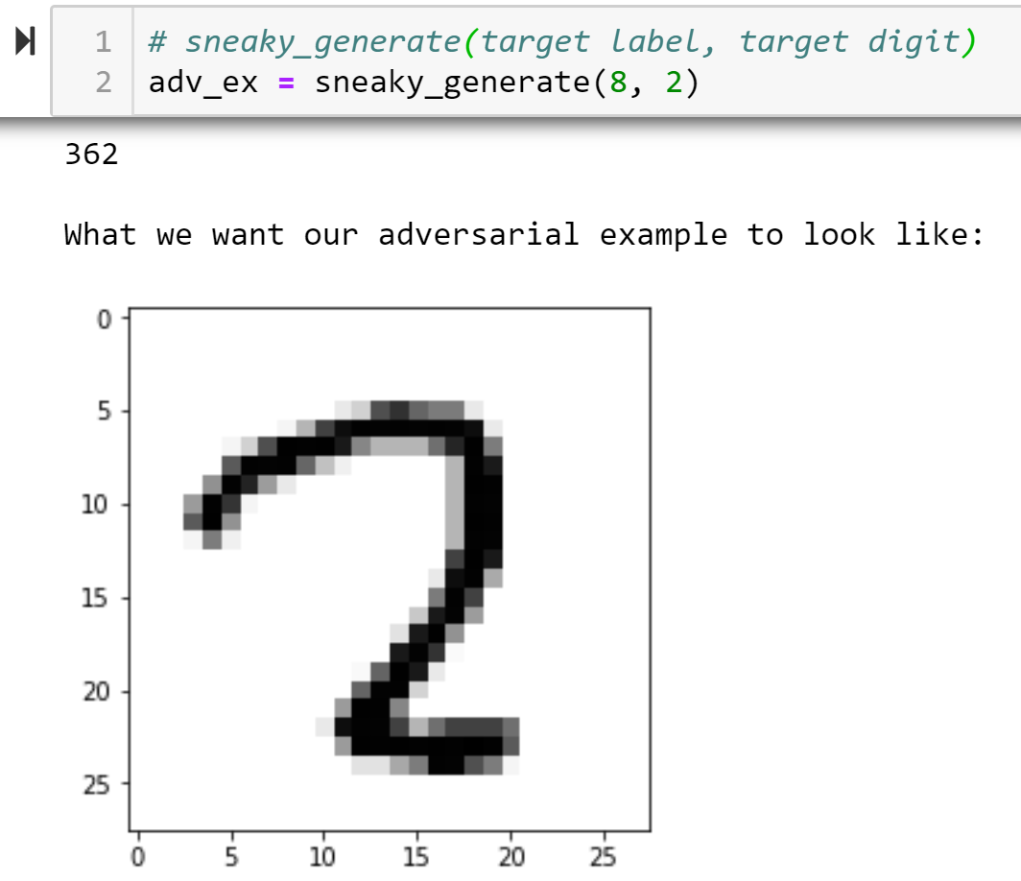
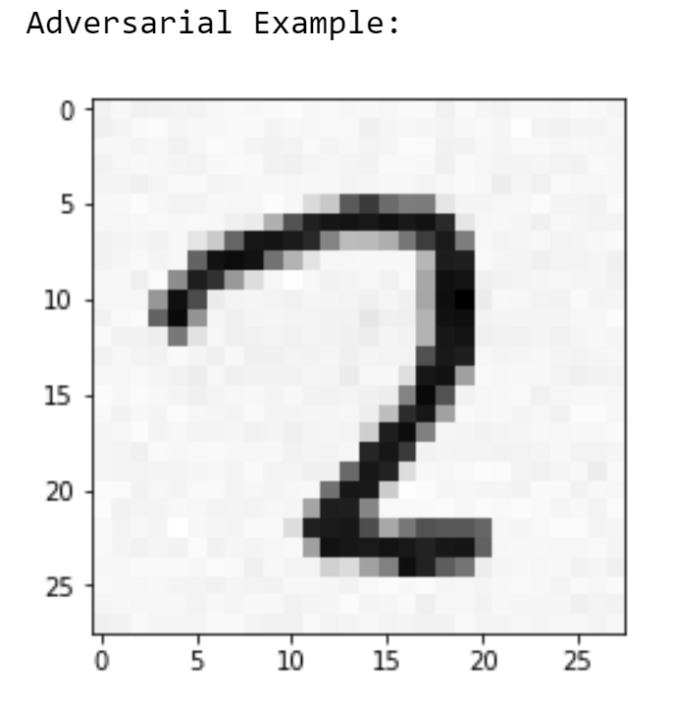
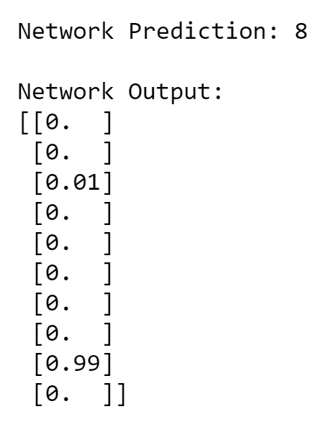
AdversArial examples
DEMO OF ADVERSARIAL EXAMPLES

Slide 15
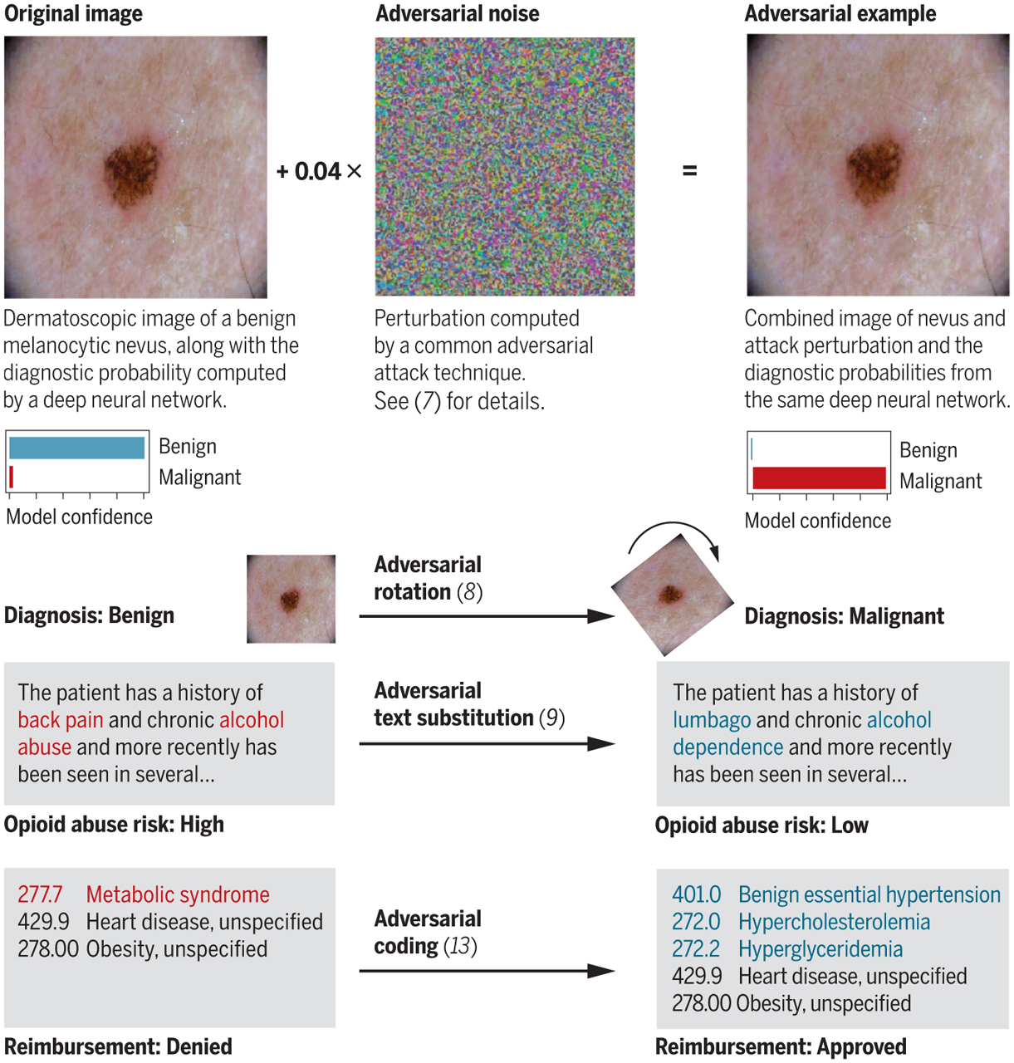
AdversArial examples
WHY ARE ADVERSARIAL EXAMPLES IMPORTANT?
https://science.sciencemag.org/content/363/6433/1287

Slide 16
AdversArial examples
WHY ARE ADVERSARIAL EXAMPLES IMPORTANT?
https://science.sciencemag.org/content/363/6433/1287

Slide 17
AdversArial examples
WHY ARE ADVERSARIAL EXAMPLES IMPORTANT?
https://science.sciencemag.org/content/363/6433/1287

Slide 18
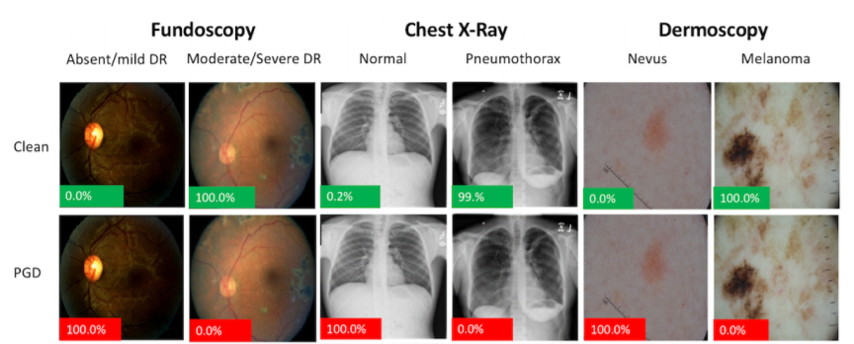
AdversArial examples
WHY ARE ADVERSARIAL EXAMPLES IMPORTANT?
https://arxiv.org/pdf/1804.05296.pdf

Slide 19
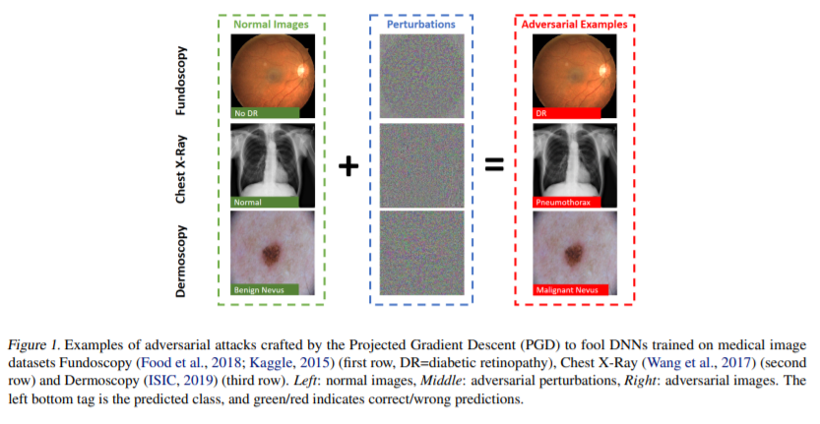
AdversArial examples
WHY ARE ADVERSARIAL EXAMPLES IMPORTANT?
https://arxiv.org/pdf/1907.10456.pdf

Slide 20
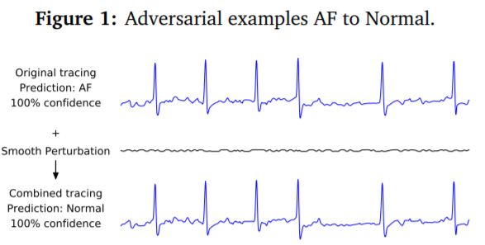
AdversArial examples
WHY ARE ADVERSARIAL EXAMPLES IMPORTANT?
https://debug-ml-iclr2019.github.io/cameraready/DebugML-19_paper_36.pdf

Slide 21
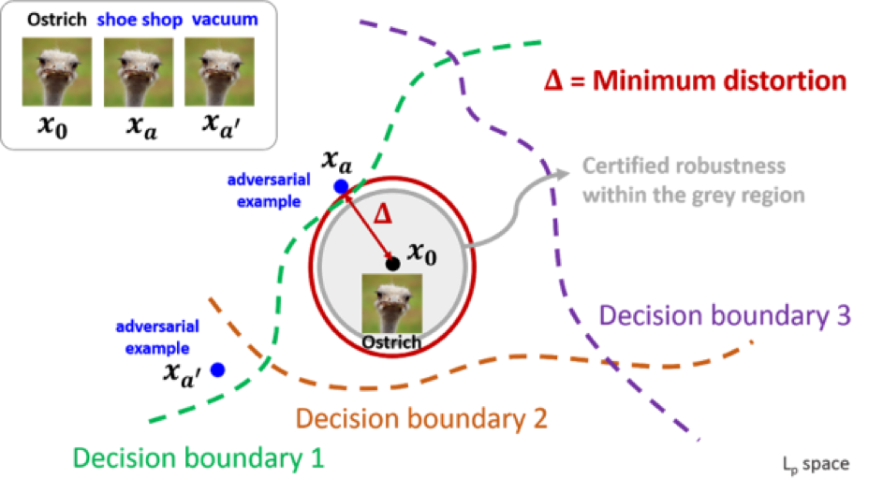
AdversArial examples
ADVERSARIAL EXAMPLES AS OVERFITTING
https://www.ibm.com/blogs/research/2018/05/clever-adversarial-attack/

Slide 22
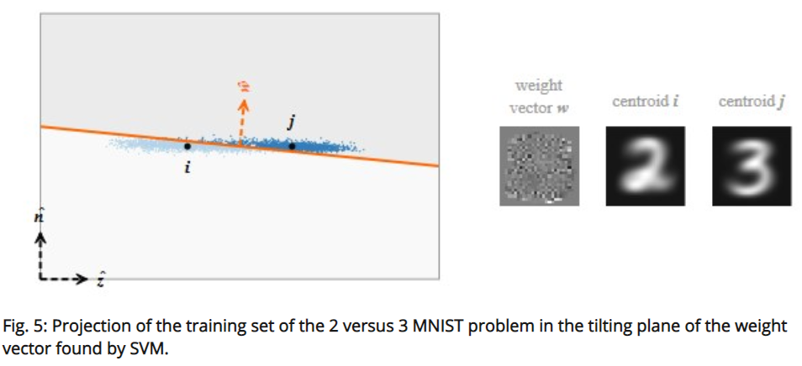
AdversArial examples
ADVERSARIAL EXAMPLES AS OVERFITTING
https://www.kdnuggets.com/2018/10/adversarial-examples-explained.html

Slide 23
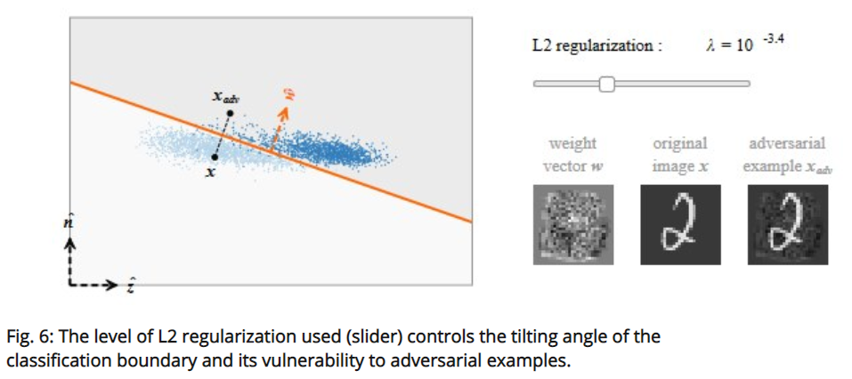
AdversArial examples
ADVERSARIAL EXAMPLES AS OVERFITTING
https://www.kdnuggets.com/2018/10/adversarial-examples-explained.html

Slide 24
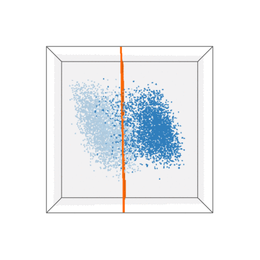
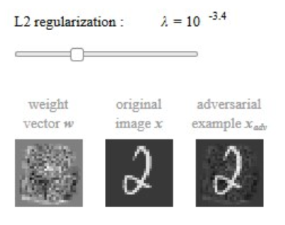
AdversArial examples
ADVERSARIAL EXAMPLES AS OVERFITTING
https://www.kdnuggets.com/2018/10/adversarial-examples-explained.html

Slide 25
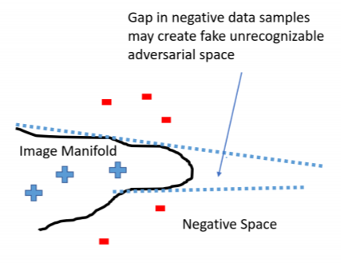
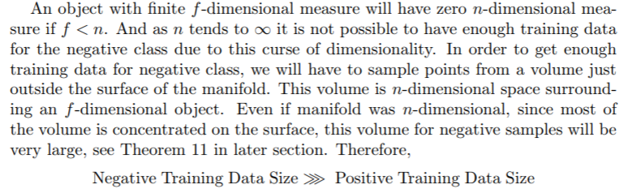
AdversArial examples
ADVERSARIAL EXAMPLES AS THE CURSE OF DIMENSIONALITY

Slide 26
AdversArial examples
ADVERSARIAL EXAMPLES CAN BE TRANSFERABLE
WHITE
BOX
(MODEL 1)
BLACK
BOX
(MODEL 2)
ADVERSARIAL EXAMPLES

Slide 27
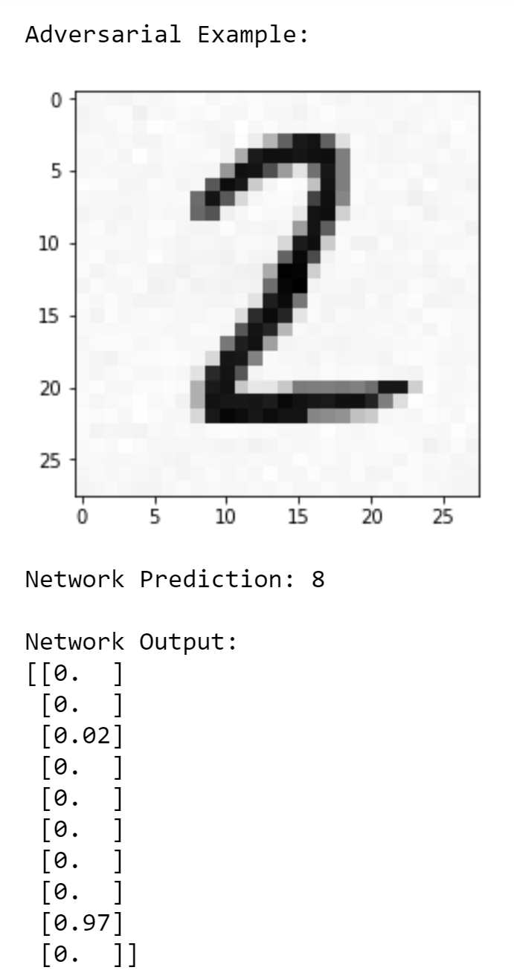
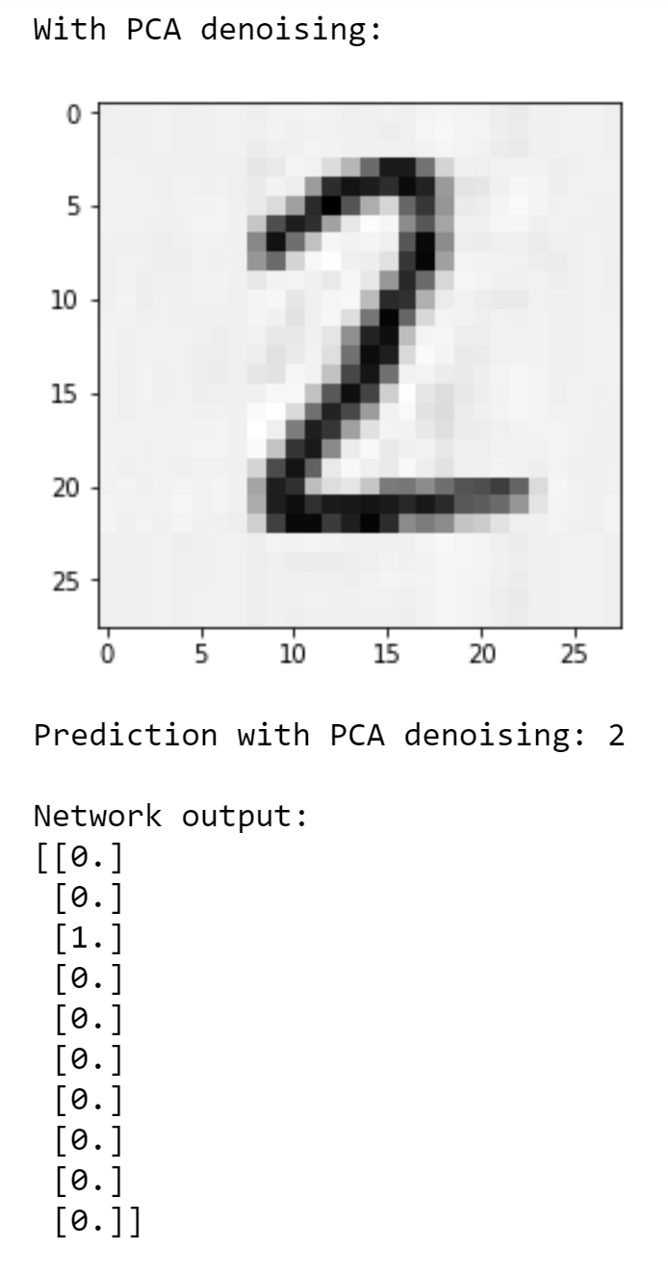
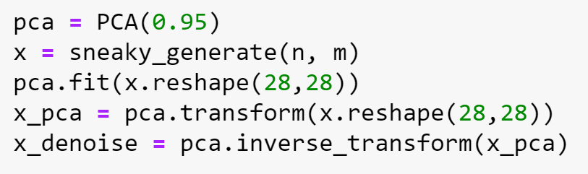
AdversArial examples
DEMO OF ADVERSARIAL EXAMPLE DEFENSE

Slide 28
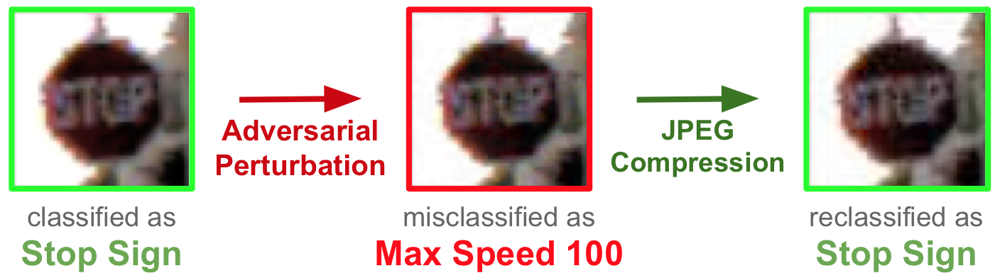
AdversArial examples
WELL-KNOWN ADVERSARIAL EXAMPLE DEFENSE

Slide 29
AdversArial examples

Slide 30
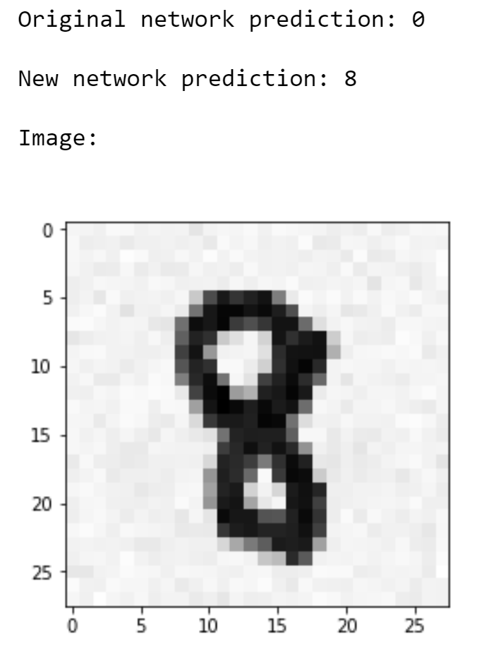
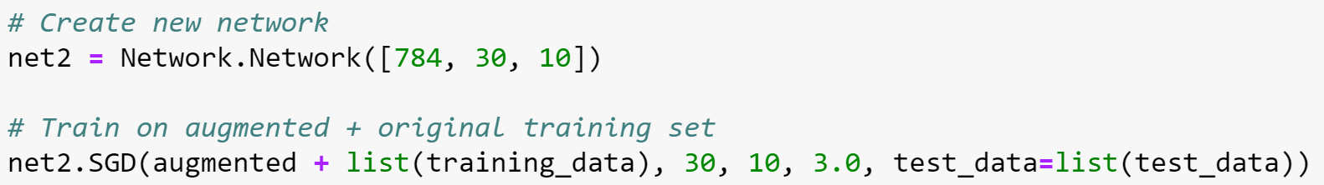
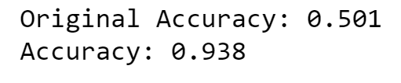
AdversArial examples
DEMO OF ADVERSARIAL TRAINING

Slide 31
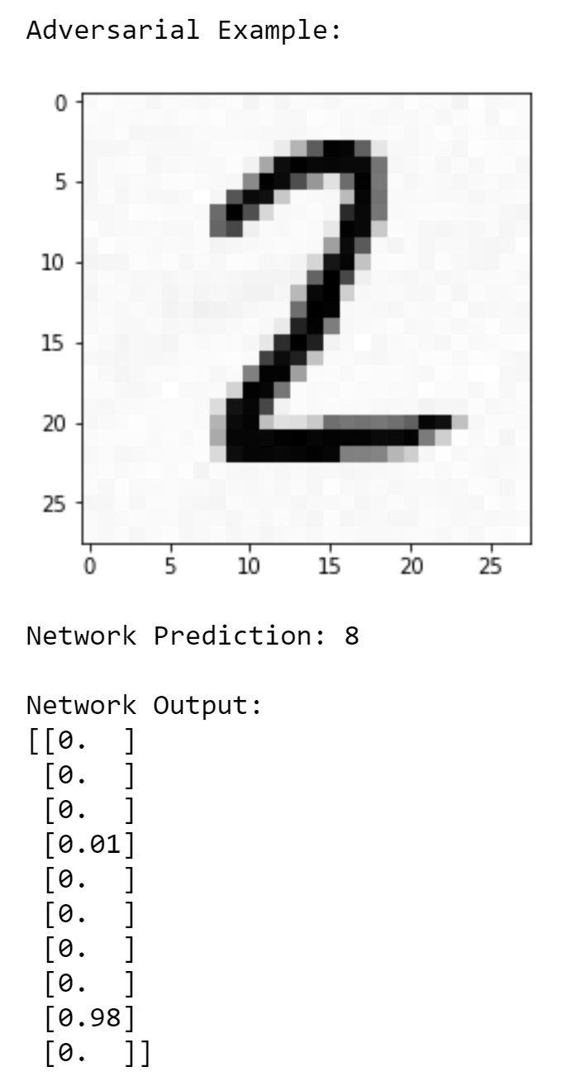
AdversArial examples
DEMO OF ADVERSARIAL TRAINING

Slide 32
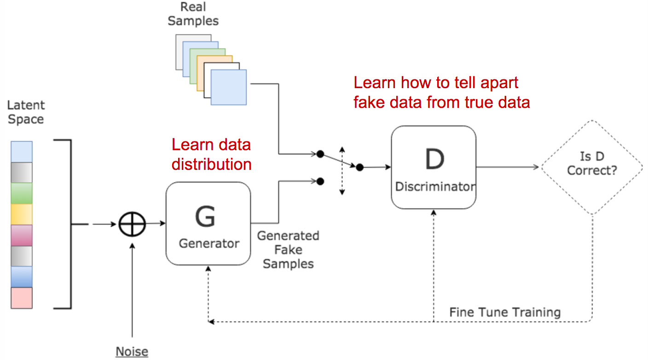
AdversArial examples
AUTOMATED ADVERSARIAL TRAINING
Generative Adversarial Networks (GAN)

Slide 33


AdversArial examples
AUTOMATED ADVERSARIAL TRAINING
Generative Adversarial Networks (GAN)

Slide 34

AdversArial examples
GENERATIVE ADVERSARIAL NETWORKS

Slide 35

AdversArial examples
GENERATIVE ADVERSARIAL NETWORKS

Slide 36
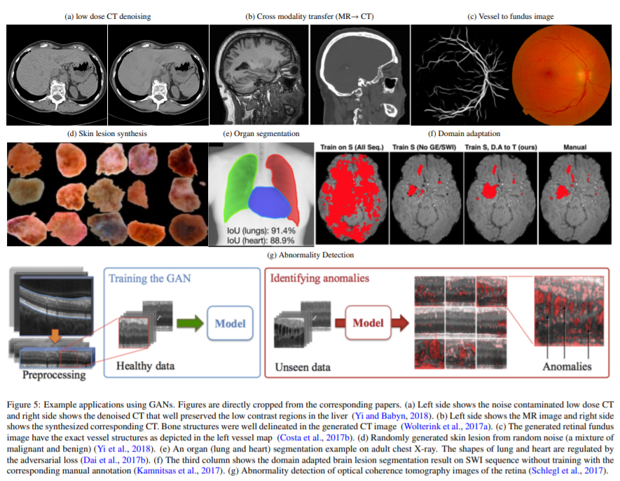

AdversArial examples
GENERATIVE ADVERSARIAL NETWORKS

Slide 37

TIME-OUT?

Slide 38
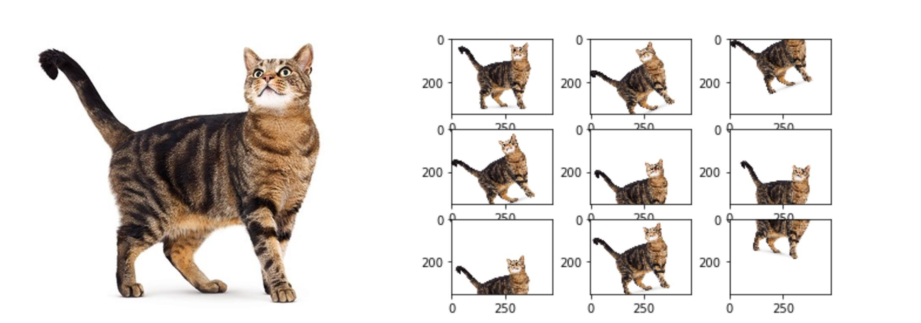
DATA AUGMENTATION
GENERAL DATA AUGMENTATION

Slide 39
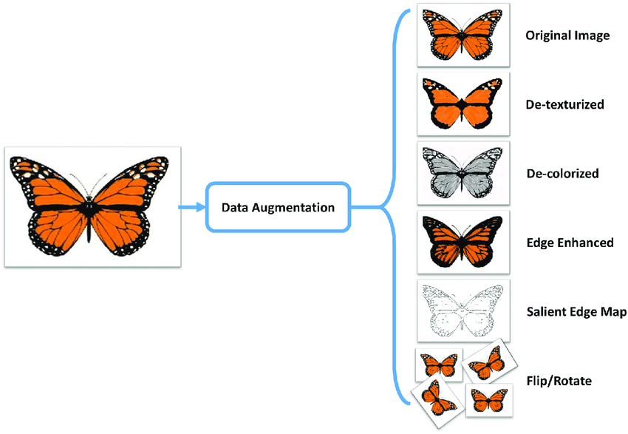
DATA AUGMENTATION
GENERAL DATA AUGMENTATION

Slide 40
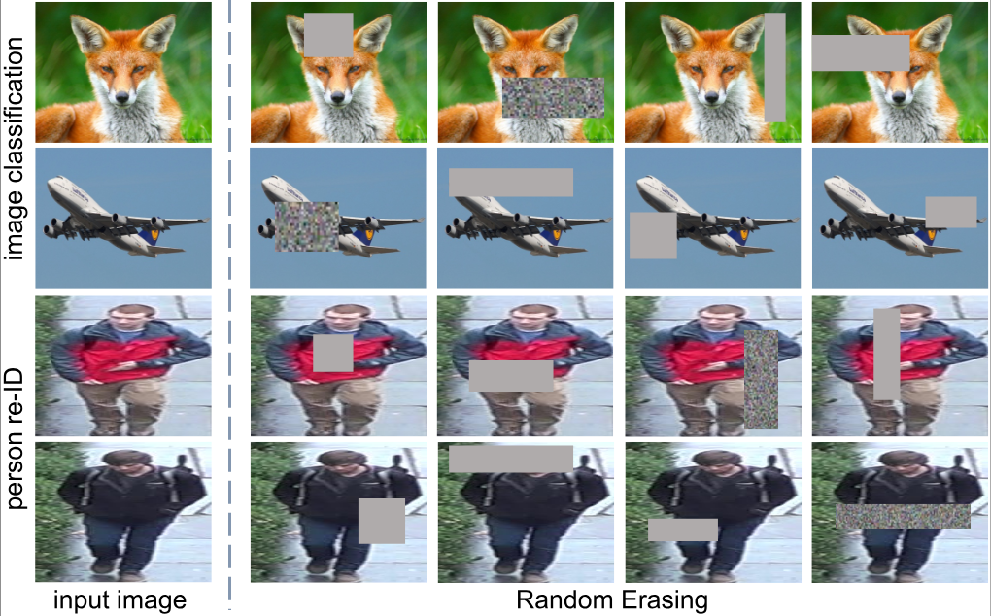
DATA AUGMENTATION
GENERAL DATA AUGMENTATION

Slide 41
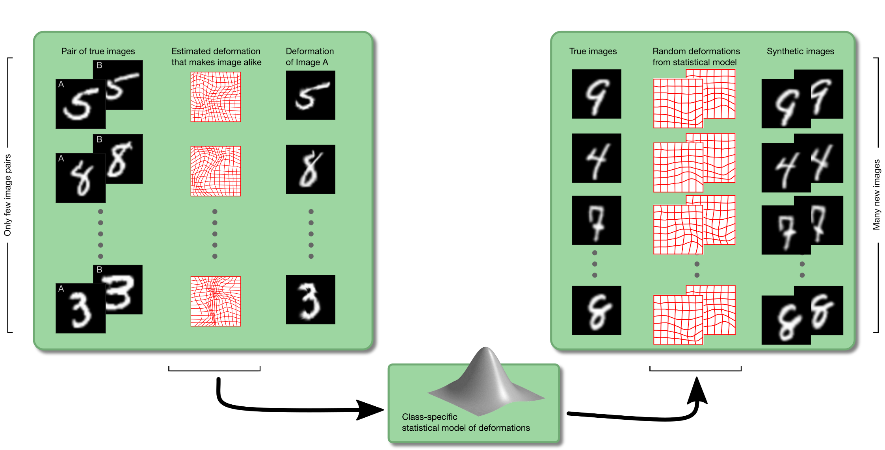
DATA AUGMENTATION
GENERAL DATA AUGMENTATION
http://www2.compute.dtu.dk/~sohau/augmentations/

Slide 42
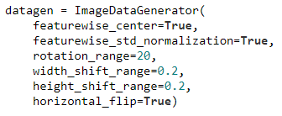
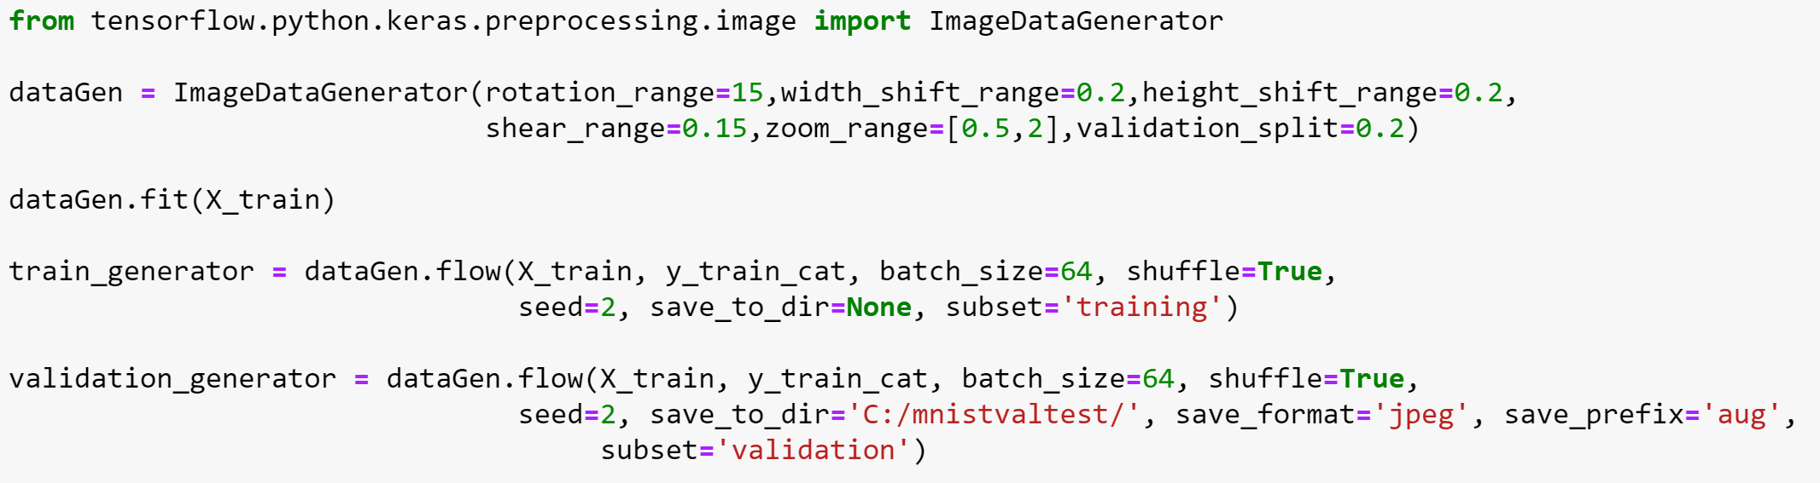
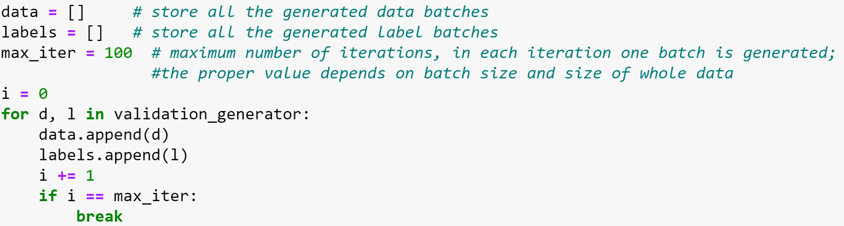
DATA AUGMENTATION
KERAS DATA AUGMENTATION
Just declarations, no augmented images generated yet
Augmented images generated inline
Augmented images extracted
https://stackoverflow.com/questions/50928329/getting-x-test-y-test-from-generator-in-keras

Slide 43
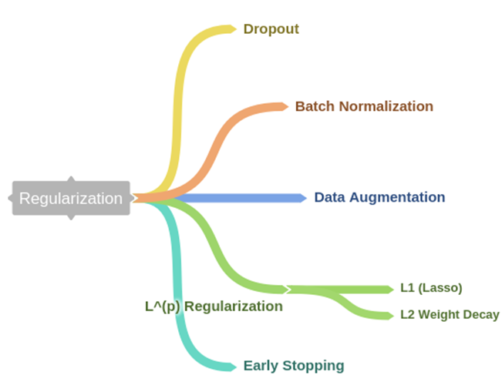
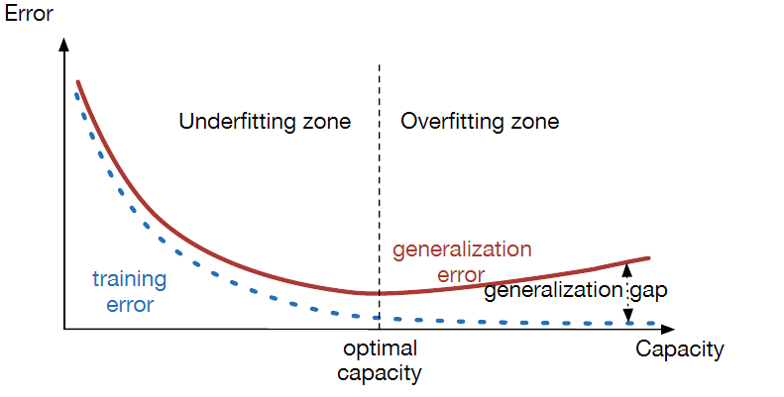

DATA AUGMENTATION
DATA AUGMENTATION AS REGULARIZATION
https://medium.com/@rameshkjes/overfitting-and-regularization-in-neural-networks-d3d996e33c3

Slide 44


DATA AUGMENTATION
DATA AUGMENTATION TRADE-OFF?

Slide 45


DATA AUGMENTATION
DATA AUGMENTATION TRADE-OFF?

Slide 46

DATA AUGMENTATION
MEDICAL DATA AUGMENTATION
What is realistic data?
Is it even known?
What are the risks?
https://www.semanticscholar.org/paper/GAN-based-synthetic-brain-MR-image-generation-Hayashi-Rundo/3f95b6ff3fda46db7fae313f5412759b86da0341

Slide 47


DATA AUGMENTATION
THE INVERSE CRIME
forward source simulation
backward source reconstruction

Slide 48
DATA AUGMENTATION
THE INVERSE CRIME IN DATA AUGMENTATION
MODEL
SYNTHETIC DATA
MACHINE
LEARNING
Are we just learning the model we already have?

Slide 49
AdversArial examples
ADVERSARIAL ADVERSARIAL TRAINING

Slide 50


AdversArial examples
ADVERSARIAL ADVERSARIAL TRAINING

Slide 51



AdversArial examples
ADVERSARIAL TASKS

Slide 52

AdversArial examples
ADVERSARIAL TASKS

Slide 53



AdversArial examples
PHYSICAL EXAMPLES OF ADVERSARIAL EXAMPLES

Slide 54



AdversArial examples
PHYSICAL EXAMPLES OF ADVERSARIAL EXAMPLES
https://www.youtube.com/watch?v=XaQu7kkQBPc

Slide 55


AdversArial examples
WANNA TRY ON YOUR SMARTPHONE?
OBS: Google Lens can’t recognize rifles..

